Slide 1
Chapter 8: Main Memory

Slide 2
Chapter 8: Memory Management
Structure of the Page Table
Segmentation
Example: The Intel Pentium

Slide 3
Memory Protection
Memory protection implemented by associating protection bit with each frame to indicate if read-only or read-write access is allowed
Can also add more bits to indicate page execute-only, and so on
Valid-invalid bit attached to each entry in the page table:
“valid” indicates that the associated page is in the process’ logical address space, and is thus a legal page
“invalid” indicates that the page is not in the process’ logical address space
Or use page table length register ( PTLR)
Any violations result in a trap to the kernel

Slide 4
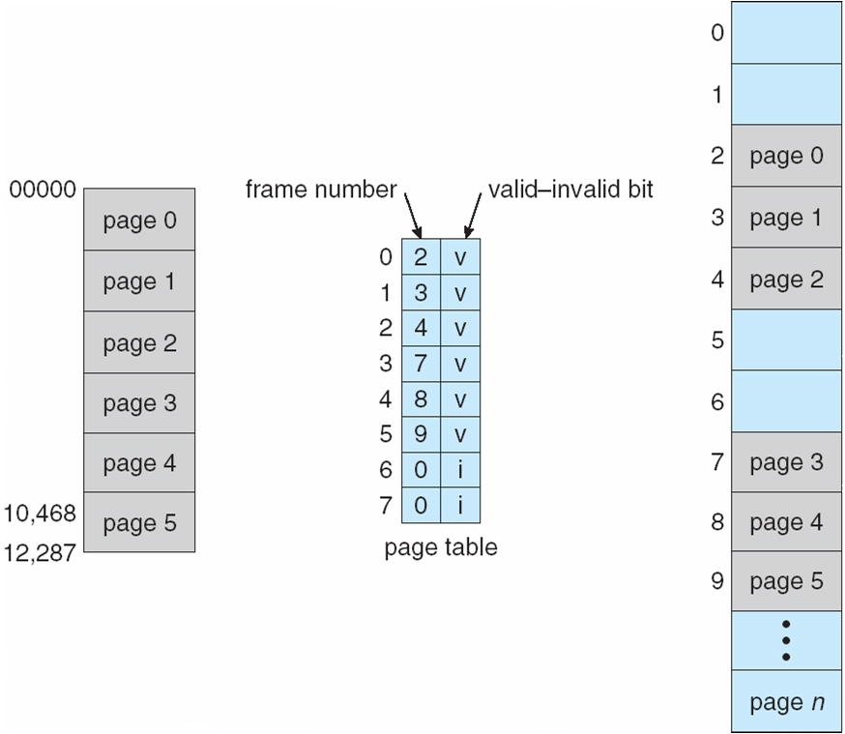
Valid (v) or Invalid (i) Bit In A Page Table

Slide 5
Shared Pages
Shared code
One copy of read-only (reentrant) code shared among processes (i.e., text editors, compilers, window systems)
Similar to multiple threads sharing the same process space
Also useful for interprocess communication if sharing of read-write pages is allowed
Private code and data
Each process keeps a separate copy of the code and data
The pages for the private code and data can appear anywhere in the logical address space

Slide 6
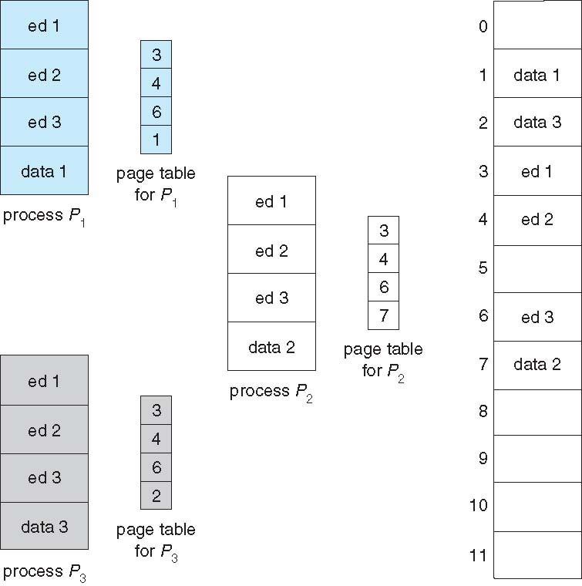
Shared Pages Example

Slide 7
Structure of the Page Table
Memory structures for paging can get huge using straight-forward methods
Consider a 32-bit logical address space as on modern computers
Page size of 4 KB (2¹²)
Page table would have 1 million entries (2³² / 2¹²)
If each entry is 4 bytes -> 4 MB of physical address space / memory for page table alone
That amount of memory used to cost a lot
Don’t want to allocate that contiguously in main memory
Hierarchical Paging
Hashed Page Tables
Inverted Page Tables

Slide 8
Hierarchical Page Tables
Break up the logical address space into multiple page tables
A simple technique is a two-level page table
We then page the page table

Slide 9
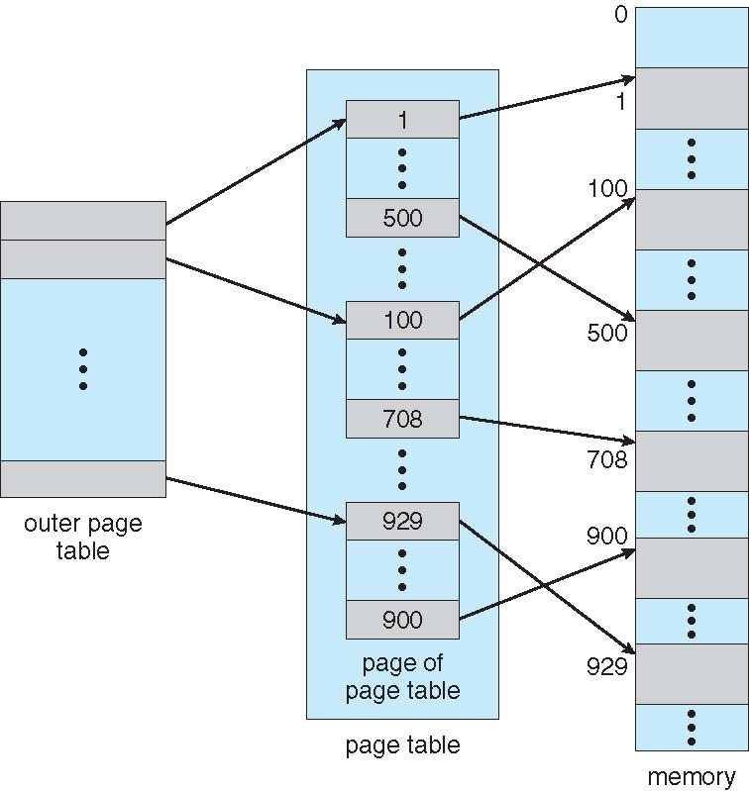
Two-Level Page-Table Scheme

Slide 10
Two-Level Paging Example
A logical address (on 32-bit machine with 1K page size) is divided into:
a page number consisting of 22 bits
a page offset consisting of 10 bits
Since the page table is paged, the page number is further divided into:
a 12-bit page number
a 10-bit page offset
Thus, a logical address is as follows:
where p₁ is an index into the outer page table, and p₂ is the displacement within the page of the inner page table
Known as forward-mapped page table
page number
page offset
p₁
p₂
d
12
10
10

Slide 11
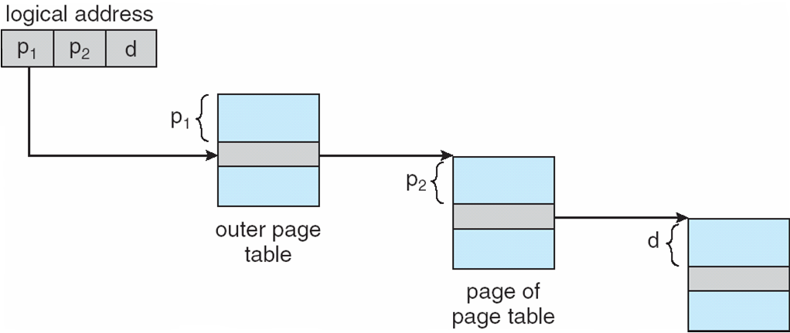
Address-Translation Scheme

Slide 12
64-bit Logical Address Space
Even two-level paging scheme not sufficient
If page size is 4 KB (2¹²)
Then page table has 2⁵² entries
If two level scheme, inner page tables could be 2¹⁰ 4-byte entries
Address would look like
Outer page table has 2⁴² entries or 2⁴⁴ bytes
One solution is to add a 2nd outer page table
But in the following example the 2nd outer page table is still 2³⁴ bytes in size
And possibly 4 memory access to get to one physical memory location
p₁
p₂
d
42
10
12
outer page
inner page
page offset

Slide 13
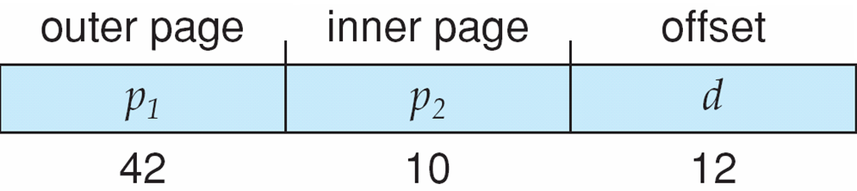
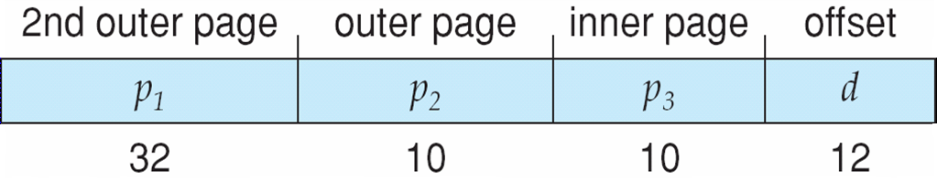
Three-level Paging Scheme

Slide 14
Hashed Page Tables
Common in address spaces > 32 bits
The virtual page number is hashed into a page table
This page table contains a chain of elements hashing to the same location
Each element contains (1) the virtual page number (2) the value of the mapped page frame (3) a pointer to the next element
Virtual page numbers are compared in this chain searching for a match
If a match is found, the corresponding physical frame is extracted

Slide 15
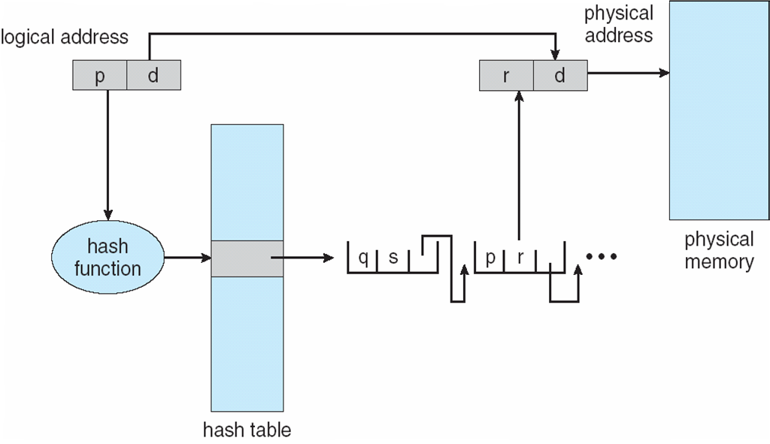
Hashed Page Table

Slide 16
Inverted Page Table
Rather than each process having a page table and keeping track of all possible logical pages, track all physical pages
One entry for each real frame of memory
Entry consists of the virtual address of the page stored in that real memory location, with information about the process that owns that page
Decreases memory needed to store each page table, but increases time needed to search the table when a page reference occurs
Use hash table to limit the search to one — or at most a few — page-table entries
TLB can accelerate access
But how to implement shared memory?
One mapping of a virtual address to the shared physical address

Slide 17
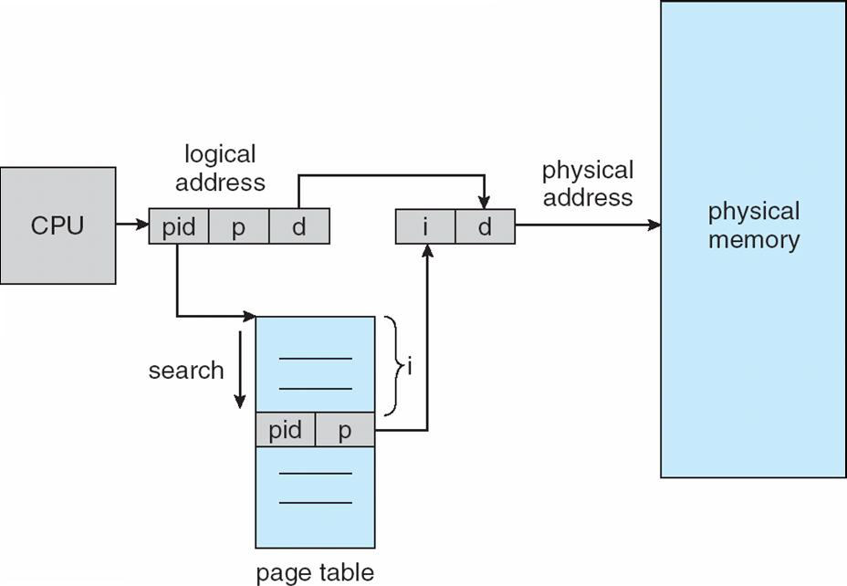
Inverted Page Table Architecture

Slide 18
Segmentation
Memory-management scheme that supports user view of memory
A program is a collection of segments
A segment is a logical unit such as:
main program
procedure
function
method
object
local variables, global variables
common block
stack
symbol table
arrays

Slide 19
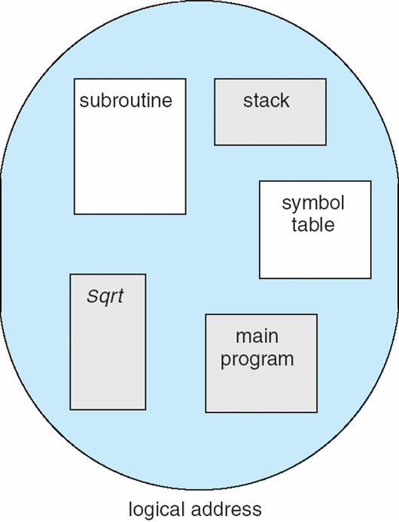
User’s View of a Program

Slide 20
Logical View of Segmentation
1
1
4
2
3
4
2
3
user space
physical memory space

Slide 21
Segmentation Architecture
Logical address consists of a two tuple:
<segment-number, offset>,
Segment table – maps two-dimensional physical addresses; each table entry has:
base – contains the starting physical address where the segments reside in memory
limit – specifies the length of the segment
Segment-table base register (STBR) points to the segment table’s location in memory
Segment-table length register (STLR) indicates number of segments used by a program;
segment number s is legal if s < STLR

Slide 22
Segmentation Architecture (Cont.)
Memory protection in a segmentation system
The virtual segment number, s, is compared against the Segment Table Length Register
The virtual displacement, d, is compared to the size of the segment length
Read, write, execute bits are set in the slot for the segment s

Slide 23
Segmentation Architecture (Cont.)
Protection
With each entry in segment table associate:
validation bit = 0 ⇒ illegal segment
read/write/execute privileges
Protection bits associated with segments; code sharing occurs at segment level
Since segments vary in length, memory allocation is a dynamic storage-allocation problem
A segmentation example is shown in the following diagram

Slide 24
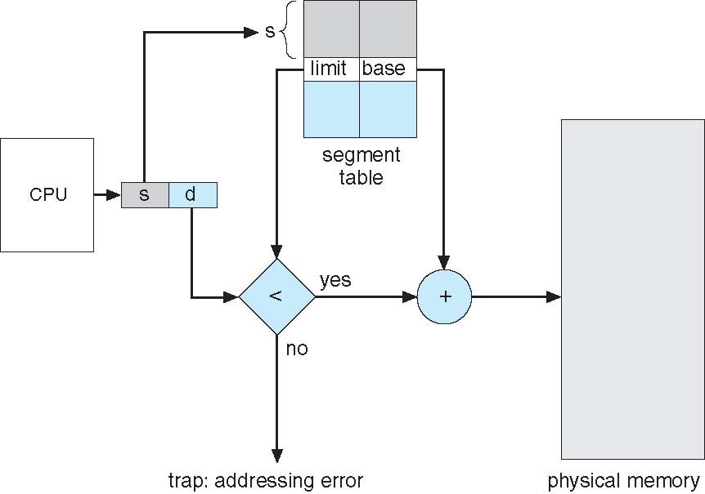
Segmentation Hardware

Slide 25
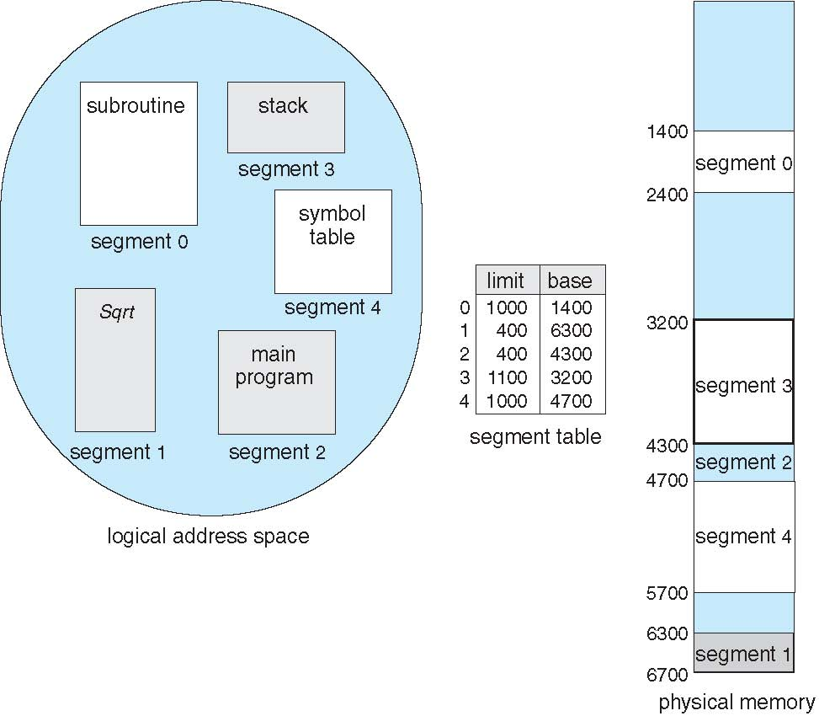
Example of Segmentation

Slide 26
Example: The Intel Pentium
Supports both segmentation and segmentation with paging
Each segment can be 4 GB
Up to 16 K segments per process
Divided into two partitions
First partition of up to 8 K segments are private to process (kept in local descriptor table LDT)
Second partition of up to 8K segments shared among all processes (kept in global descriptor table GDT)
CPU generates logical address
Given to segmentation unit
Which produces linear addresses
Linear address given to paging unit
Which generates physical address in main memory
Paging units form equivalent of MMU
Pages sizes can be 4 KB or 4 MB

Slide 27
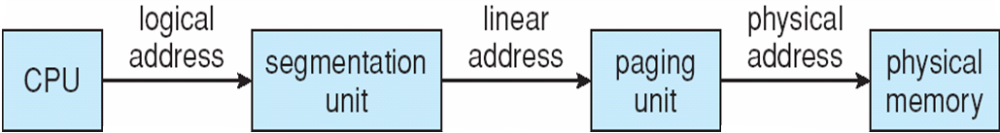
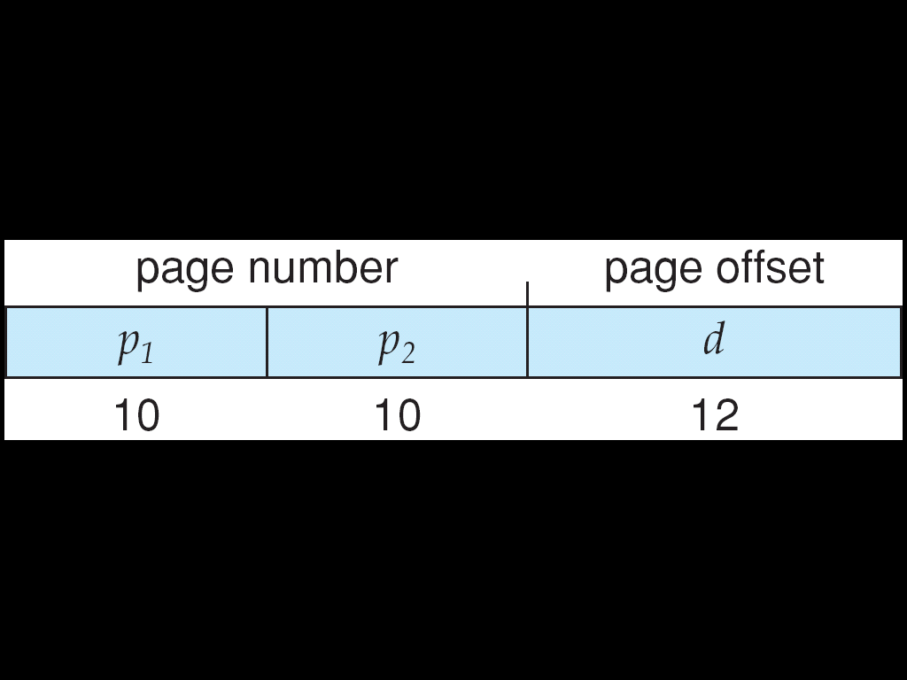
Logical to Physical Address Translation in Pentium

Slide 28
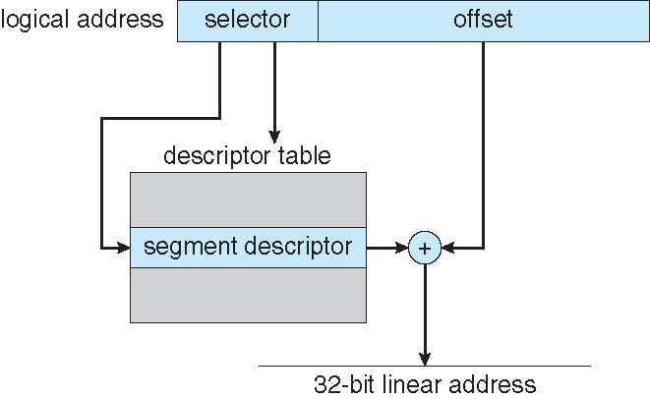
Intel Pentium Segmentation

Slide 29
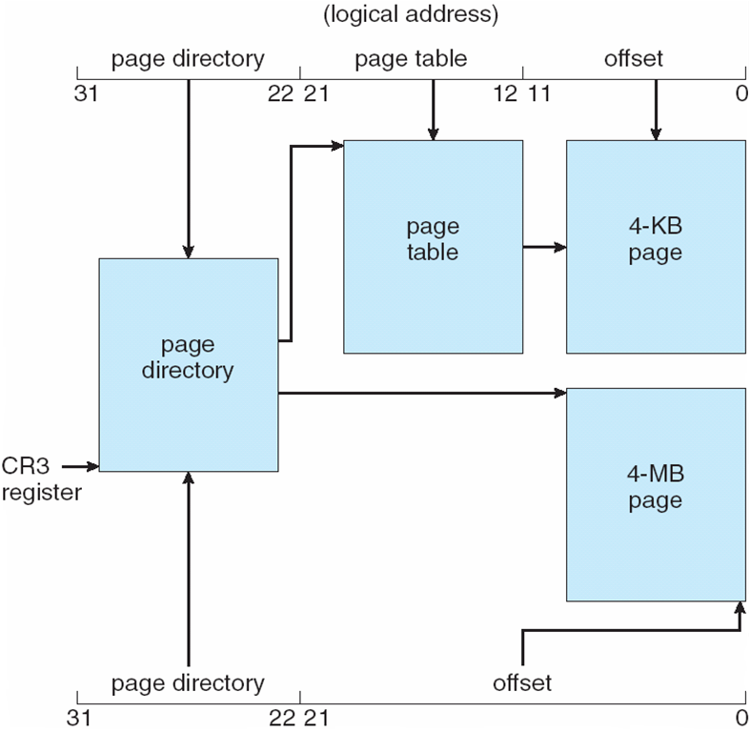
Pentium Paging Architecture

Slide 30

Linear Address in Linux
Linux uses only 6 segments (kernel code, kernel data, user code, user data, task-state segment (TSS), default LDT segment)
Linux only uses two modes – kernel and user
Uses a three-level paging strategy that works well for 32-bit and 64-bit systems
Linear address broken into four parts:
But the Pentium only supports 2-level paging?!

Slide 31
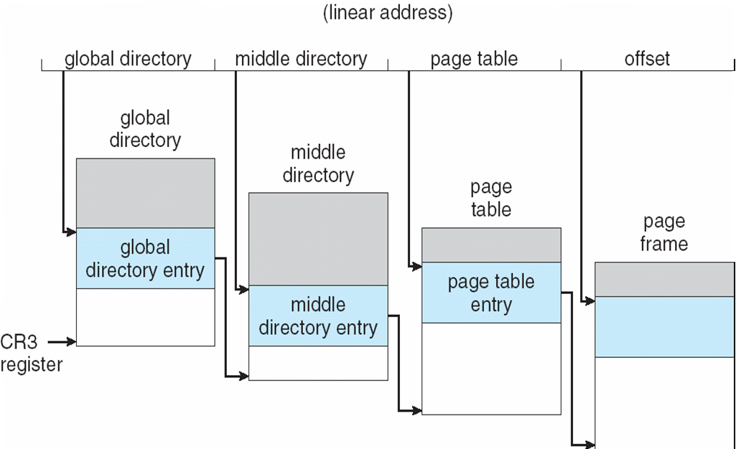
Three-level Paging in Linux

Slide 32
End of Chapter 8

